Slide 1
Roadmap
Part I: Priority Queues
Binary Heaps
HeapSort
Part II: Disjoint Set
Problem: Dynamic Connectivity
Algorithm: Union-Find
Applications

Slide 2
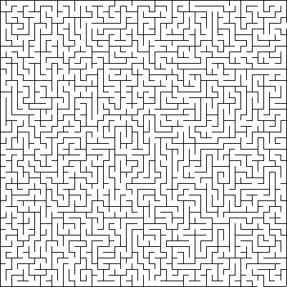
Mazes
z
Is there any route from y to z?
y

Slide 3
Best way to find if there is a route from Y to Z?
z
Breadth-first search
Depth-first search
Topological sort
Quicksort
y
0 of 50

Slide 4
Mazes
z
Two steps:
Pre-process maze
Answer queries
isConnected(y,z) :
Returns true if there is a path from A to B, and false otherwise.
y

Slide 5
Mazes
Preprocess:
Identify connected components. Label each location with its component number.
isConnected(y,z) :
Returns true if A and B are in the same connected component.
A
E
C
B
F
D

Slide 6
Mazes
Preprocess:
Prepare to answer queries.
destroyWall(x):
Remove walls from the maze using your superpowers.
isConnected(y, z):
Answer connectivity queries.
A
E
C
B
F
D

Slide 7
Mazes
Preprocess:
Prepare to answer queries.
destroyWall(x):
Remove walls from the maze using your superpowers.
isConnected(y, z):
Answer connectivity queries.
A
E
C
B
D

Slide 8
Dynamic Connectivity
Given a set of objects:
Union: connect two objects
Find: is there a path connecting the two objects?
union(E, F)
union(I, G)
union(D, E)
union(B, A)
find(G, D) = false
find(D, F) = true
union(B, C)
union(H, E)
union(A, C)
union(F, I)
find(G, D) = true
A
B
C
D
E
F
G
H
I

Slide 9
Dynamic Connectivity
Given a set of objects:
Union: connect two objects
Find: is there a path connecting the two objects?
Transitivity
If p is connected to q and if q is connected to r, then p is connected to r.
Connected components:
Maximal set of mutually connected objects.
A
B
C
D
E
F
G
H
I

Slide 10
Dynamic Connectivity
Given a set of objects:
Union: connect two objects
Find: is there a path connecting the two objects?
Maintain sets of connected components:
{A, B, C}
{D, E, F, H}
{G, I}
A
B
C
D
E
F
G
H
I

Slide 11
Dynamic Connectivity
Given a set of objects:
Union: connect two objects
Find: is there a path connecting the two objects?
Maintain sets of connected components:
{A, B, C}
{D, E, F, H, G, I}
A
B
C
D
E
F
G
H
I

Slide 12
Abstract Data Type
Disjoint Set (Union-Find)
 | DisjointSet(int N) | constructor: N objects
boolean | find(Key p, Key q) | are p and q in the same set?
void | union(Key p, Key q) | replace sets containing p and q with their union

Slide 13
Roadmap
Part II: Disjoint Set
Problem: Dynamic Connectivity
Algorithm: Quick-Find
Algorithm: Quick-Union
Optimizations
Applications

Slide 14
Quick Find
Data structure:
Array: componentId
Two objects are connected if they have the same component identifier.
object |  | 0 | 1 | 2 | 3 | 4 | 5 | 6 | 7 | 8
component identifier |  | A | B | B | C | A | B | A | B | C
component B
0
6
4
1
7
5
component A
3
2
8
component C

Slide 15
Quick Find
Assume objects
are integers
Data structure:
Integer array: int[] componentId
Two objects are connected if they have the same component identifier.
object |  | 0 | 1 | 2 | 3 | 4 | 5 | 6 | 7 | 8
component identifier |  | 0 | 1 | 1 | 3 | 0 | 1 | 0 | 1 | 3
component 1
0
6
4
1
7
5
component 0
3
2
8
component 3

Slide 16
If objects are not integers, how could we convert them to integers?
Binary search tree
Hash function
Hash table + chaining
Hash table + open addressing
Bloom filter
Priority queue
Response Counter

Slide 17
Quick Find
Data structure:
Integer array: int[] componentId
Two objects are connected if they have the same component identifier.
object |  | 0 | 1 | 2 | 3 | 4 | 5 | 6 | 7 | 8
component identifier |  | 0 | 1 | 1 | 3 | 0 | 1 | 0 | 1 | 3
component 1
0
6
4
1
7
5
component 0
3
2
8
component 3

Slide 18
Quick Find
find(int p, int q)
return(componentId[p] == componentId[q]);
object |  | 0 | 1 | 2 | 3 | 4 | 5 | 6 | 7 | 8
component identifier |  | 0 | 1 | 1 | 3 | 0 | 1 | 0 | 1 | 3
component 1
0
6
4
1
7
5
component 0
3
2
8
component 3

Slide 19
Quick Find
Initial state of data structure:
object |  | 0 | 1 | 2 | 3 | 4 | 5 | 6 | 7 | 8
component identifier |  | 0 | 1 | 2 | 3 | 4 | 5 | 6 | 7 | 8
0
6
4
1
7
5
3
2
8

Slide 20
Quick Find
union(int p, int q)
for (int i=0; i<componentId.length; i++)
if (componentId[i] == componentId[q])
componentId[i] = componentId[p];
object |  | 0 | 1 | 2 | 3 | 4 | 5 | 6 | 7 | 8
component identifier |  | 0 | 1 | 2 | 3 | 1 | 5 | 6 | 7 | 8
0
6
4
1
7
5
3
2
8

Slide 21
Quick Find
union(int p, int q)
for (int i=0; i<componentId.length; i++)
if (componentId[i] == componentId[q])
componentId[i] = componentId[p];
object |  | 0 | 1 | 2 | 3 | 4 | 5 | 6 | 7 | 8
component identifier |  | 0 | 1 | 2 | 1 | 1 | 5 | 6 | 7 | 8
0
6
4
1
7
5
3
2
8

Slide 22
Quick Find
union(int p, int q)
for (int i=0; i<componentId.length; i++)
if (componentId[i] == componentId[q])
componentId[i] = componentId[p];
object |  | 0 | 1 | 2 | 3 | 4 | 5 | 6 | 7 | 8
component identifier |  | 0 | 2 | 2 | 2 | 2 | 5 | 6 | 7 | 8
0
6
4
1
7
5
3
2
8

Slide 23
Quick Find
Flat trees:
object |  | 0 | 1 | 2 | 3 | 4 | 5 | 6 | 7 | 8
component identifier |  | 0 | 2 | 2 | 2 | 2 | 5 | 6 | 7 | 8
0
2
5
6
7
8
1
3
4

Slide 24
Quick Find
Flat trees:
object |  | 0 | 1 | 2 | 3 | 4 | 5 | 6 | 7 | 8
component identifier |  | 0 | 2 | 2 | 2 | 2 | 5 | 7 | 7 | 8
0
2
5
7
8
1
3
4
6

Slide 25
Quick Find
Flat trees:
object |  | 0 | 1 | 2 | 3 | 4 | 5 | 6 | 7 | 8
component identifier |  | 0 | 2 | 2 | 2 | 2 | 5 | 2 | 2 | 8
0
2
5
8
1
3
4
7
6

Slide 26
Running time of (Find, Union):
O(1), O(1)
O(1), O(n)
O(n), O(1)
O(n), O(n)
O(log n), O(log n)
None of the above.
0 of 50

Slide 27
Quick Find
find(int p, int q)
return(componentId[p] == componentId[q]);
object |  | 0 | 1 | 2 | 3 | 4 | 5 | 6 | 7 | 8
component identifier |  | 0 | 1 | 1 | 3 | 0 | 1 | 0 | 1 | 3
component 1
0
6
4
1
7
5
component 0
3
2
8
component 3

Slide 28
Quick Find
union(int p, int q)
for (inti=0; i<componentId.length; i++)
if (componentId[i] == componentId[q])
componentId[i] = componentId[p];
object |  | 0 | 1 | 2 | 3 | 4 | 5 | 6 | 7 | 8
component identifier |  | 0 | 2 | 2 | 2 | 2 | 5 | 6 | 7 | 8
0
6
4
1
7
5
3
2
8

Slide 29
Roadmap
Part II: Disjoint Set
Problem: Dynamic Connectivity
Algorithm: Quick-Find
Algorithm: Quick-Union
Optimizations
Applications

Slide 30
Quick Union
Data structure:
Integer array: int[] parent
Two objects are connected if they are part of the same tree.
object |  | 0 | 1 | 2 | 3 | 4 | 5 | 6 | 7 | 8
parent |  | 6 | 2 | 7 | 3 | 6 | 1 | 6 | 7 | 7
7
6
3
2
8
0
4
1
5

Slide 31
Quick Union
find(int p, int q)
while (parent[p] != p) p = parent[p];
while (parent[q] != q) q = parent[q];
return (p == q);
object |  | 0 | 1 | 2 | 3 | 4 | 5 | 6 | 7 | 8
parent |  | 6 | 2 | 7 | 3 | 6 | 1 | 6 | 7 | 7
7
6
3
5
2
8
0
4
1

Slide 32
Quick Union
Example: find(4, 1)
4 → 6 → 6;
object |  | 0 | 1 | 2 | 3 | 4 | 5 | 6 | 7 | 8
parent |  | 6 | 2 | 7 | 3 | 6 | 1 | 6 | 7 | 7
7
6
3
5
2
8
0
4
1

Slide 33
Quick Union
Example: find(4, 1)
4 → 6 → 6
1 → 2 → 7 → 7
object |  | 0 | 1 | 2 | 3 | 4 | 5 | 6 | 7 | 8
parent |  | 6 | 2 | 7 | 3 | 6 | 1 | 6 | 7 | 7
7
6
3
5
2
8
0
4
1

Slide 34
Quick Union
Example: find(4, 1)
4 → 6 → 6
1 → 2 → 7 → 7
return (6 == 7) ➔ false
object |  | 0 | 1 | 2 | 3 | 4 | 5 | 6 | 7 | 8
parent |  | 6 | 2 | 7 | 3 | 6 | 1 | 6 | 7 | 7
7
6
3
5
2
8
0
4
1

Slide 35
Quick Union
find(int p, int q)
while (parent[p] != p) p = parent[p];
while (parent[q] != q) q =parent[q];
return (p == q);
object |  | 0 | 1 | 2 | 3 | 4 | 5 | 6 | 7 | 8
parent |  | 6 | 2 | 7 | 3 | 6 | 1 | 6 | 7 | 7
7
6
3
5
2
8
0
4
1

Slide 36
Quick Union
union(int p, int q)
while (parent[p] != p) p = parent[p];
while (parent[q] != q) q= parent[q];
parent[p] = q;
object |  | 0 | 1 | 2 | 3 | 4 | 5 | 6 | 7 | 8
parent |  | 6 | 2 | 7 | 3 | 6 | 1 | 6 | 7 | 7
7
6
3
5
2
8
0
4
1

Slide 37
Quick Union
Example: union(1, 4)
object |  | 0 | 1 | 2 | 3 | 4 | 5 | 6 | 7 | 8
parent |  | 6 | 2 | 7 | 3 | 6 | 1 | 6 | 7 | 7
7
6
3
5
2
8
0
4
1

Slide 38
Quick Union
Example: union(1, 4)
4 → 6 → 6
1 → 2 → 7 → 7
object |  | 0 | 1 | 2 | 3 | 4 | 5 | 6 | 7 | 8
parent |  | 6 | 2 | 7 | 3 | 6 | 1 | 6 | 7 | 7
7
6
3
5
2
8
0
4
1

Slide 39
Quick Union
Example: union(1, 4)
4 → 6 → 6
1 → 2 → 7 → 7
parent[7] = 6;
object |  | 0 | 1 | 2 | 3 | 4 | 5 | 6 | 7 | 8
parent |  | 6 | 2 | 7 | 3 | 6 | 1 | 6 | 6 | 7
7
6
3
5
2
8
0
4
1

Slide 40
Quick Union
Example: union(1, 4)
4 → 6 → 6
1 → 2 → 7 → 7
parent[7] = 6;
object |  | 0 | 1 | 2 | 3 | 4 | 5 | 6 | 7 | 8
parent |  | 6 | 2 | 7 | 3 | 6 | 1 | 6 | 6 | 7
6
7
3
5
0
4
2
8
1

Slide 41
Example:
P | 0 | 1 | 2 | 3 | 4 | 5 | 6 | 7 | 8 | 9
0
1
2
3
4
5
6
7
8
9

Slide 42
Example:
P | 0 | 1 | 2 | 3 | 4 | 5 | 6 | 7 | 8 | 9
3-4 | 0 | 1 | 2 | 4 | 4 | 5 | 6 | 7 | 8 | 9
0
1
2
3
4
5
6
7
8
9
0
1
2
4
5
6
7
8
9
3

Slide 43
Example:
P | 0 | 1 | 2 | 3 | 4 | 5 | 6 | 7 | 8 | 9
3-4 | 0 | 1 | 2 | 4 | 4 | 5 | 6 | 7 | 8 | 9
4-9 | 0 | 1 | 2 | 4 | 9 | 5 | 6 | 7 | 8 | 9
0
1
2
3
4
5
6
7
8
9
0
1
2
4
5
6
7
8
9
3
0
1
2
5
6
7
8
9
4
3

Slide 44
Example:
P | 0 | 1 | 2 | 3 | 4 | 5 | 6 | 7 | 8 | 9
3-4 | 0 | 1 | 2 | 4 | 4 | 5 | 6 | 7 | 8 | 9
4-9 | 0 | 1 | 2 | 4 | 9 | 5 | 6 | 7 | 8 | 9
8-0 | 0 | 1 | 2 | 4 | 9 | 5 | 6 | 7 | 0 | 9
0
1
2
3
4
5
6
7
8
9
0
1
2
4
5
6
7
8
9
3
0
1
2
5
6
7
8
9
4
3
0
1
2
5
6
7
9
8
4
3

Slide 45
Example:
P | 0 | 1 | 2 | 3 | 4 | 5 | 6 | 7 | 8 | 9
3-4 | 0 | 1 | 2 | 4 | 4 | 5 | 6 | 7 | 8 | 9
4-9 | 0 | 1 | 2 | 4 | 9 | 5 | 6 | 7 | 8 | 9
8-0 | 0 | 1 | 2 | 4 | 9 | 5 | 6 | 7 | 0 | 9
2-3 | 0 | 1 | 9 | 4 | 9 | 5 | 6 | 7 | 0 | 9
0
1
2
3
4
5
6
7
8
9
0
1
2
4
5
6
7
8
9
3
0
1
2
5
6
7
8
9
4
3
0
1
2
5
6
7
9
8
4
3
0
1
5
6
7
9
8
4
2
3

Slide 46
Example:
P | 0 | 1 | 2 | 3 | 4 | 5 | 6 | 7 | 8 | 9
3-4 | 0 | 1 | 2 | 4 | 4 | 5 | 6 | 7 | 8 | 9
4-9 | 0 | 1 | 2 | 4 | 9 | 5 | 6 | 7 | 8 | 9
8-0 | 0 | 1 | 2 | 4 | 9 | 5 | 6 | 7 | 0 | 9
2-3 | 0 | 1 | 9 | 4 | 9 | 5 | 6 | 7 | 0 | 9
5-6 | 0 | 1 | 9 | 4 | 9 | 6 | 6 | 7 | 0 | 9
0
1
2
3
4
5
6
7
8
9
0
1
2
4
5
6
7
8
9
3
0
1
2
5
6
7
8
9
4
3
0
1
2
5
6
7
9
8
4
3
0
1
5
6
7
9
8
4
2
3
0
1
6
7
9
8
5
4
2
3

Slide 47
Example:
P | 0 | 1 | 2 | 3 | 4 | 5 | 6 | 7 | 8 | 9
3-4 | 0 | 1 | 2 | 4 | 4 | 5 | 6 | 7 | 8 | 9
4-9 | 0 | 1 | 2 | 4 | 9 | 5 | 6 | 7 | 8 | 9
8-0 | 0 | 1 | 2 | 4 | 9 | 5 | 6 | 7 | 0 | 9
2-3 | 0 | 1 | 9 | 4 | 9 | 5 | 6 | 7 | 0 | 9
5-6 | 0 | 1 | 9 | 4 | 9 | 6 | 6 | 7 | 0 | 9
0
1
6
7
9
8
5
4
2
3

Slide 48
Example:
P | 0 | 1 | 2 | 3 | 4 | 5 | 6 | 7 | 8 | 9
3-4 | 0 | 1 | 2 | 4 | 4 | 5 | 6 | 7 | 8 | 9
4-9 | 0 | 1 | 2 | 4 | 9 | 5 | 6 | 7 | 8 | 9
8-0 | 0 | 1 | 2 | 4 | 9 | 5 | 6 | 7 | 0 | 9
2-3 | 0 | 1 | 9 | 4 | 9 | 5 | 6 | 7 | 0 | 9
5-6 | 0 | 1 | 9 | 4 | 9 | 6 | 6 | 7 | 0 | 9
5-9 | 0 | 1 | 9 | 4 | 9 | 6 | 9 | 7 | 0 | 9
0
1
6
7
9
8
5
4
2
3
0
1
7
9
8
6
4
2
5
3

Slide 49
Example:
P | 0 | 1 | 2 | 3 | 4 | 5 | 6 | 7 | 8 | 9
3-4 | 0 | 1 | 2 | 4 | 4 | 5 | 6 | 7 | 8 | 9
4-9 | 0 | 1 | 2 | 4 | 9 | 5 | 6 | 7 | 8 | 9
8-0 | 0 | 1 | 2 | 4 | 9 | 5 | 6 | 7 | 0 | 9
2-3 | 0 | 1 | 9 | 4 | 9 | 5 | 6 | 7 | 0 | 9
5-6 | 0 | 1 | 9 | 4 | 9 | 6 | 6 | 7 | 0 | 9
5-9 | 0 | 1 | 9 | 4 | 9 | 6 | 9 | 7 | 0 | 9
7-3 | 0 | 1 | 9 | 4 | 9 | 6 | 9 | 9 | 0 | 9
0
1
6
7
9
8
5
4
2
3
0
1
7
9
8
6
4
2
5
3
0
1
9
8
7
6
4
2
5
3

Slide 50
Example:
P | 0 | 1 | 2 | 3 | 4 | 5 | 6 | 7 | 8 | 9
3-4 | 0 | 1 | 2 | 4 | 4 | 5 | 6 | 7 | 8 | 9
4-9 | 0 | 1 | 2 | 4 | 9 | 5 | 6 | 7 | 8 | 9
8-0 | 0 | 1 | 2 | 4 | 9 | 5 | 6 | 7 | 0 | 9
2-3 | 0 | 1 | 9 | 4 | 9 | 5 | 6 | 7 | 0 | 9
5-6 | 0 | 1 | 9 | 4 | 9 | 6 | 6 | 7 | 0 | 9
5-9 | 0 | 1 | 9 | 4 | 9 | 6 | 9 | 7 | 0 | 9
7-3 | 0 | 1 | 9 | 4 | 9 | 6 | 9 | 9 | 0 | 9
4-8 | 0 | 1 | 9 | 4 | 9 | 6 | 9 | 9 | 0 | 0
0
1
6
7
9
8
5
4
2
3
0
1
7
9
8
6
4
2
5
3
0
1
9
8
7
6
4
2
0
1
5
3
8
9
7
6
4
2
5
3

Slide 51
Example:
P | 0 | 1 | 2 | 3 | 4 | 5 | 6 | 7 | 8 | 9
3-4 | 0 | 1 | 2 | 4 | 4 | 5 | 6 | 7 | 8 | 9
4-9 | 0 | 1 | 2 | 4 | 9 | 5 | 6 | 7 | 8 | 9
8-0 | 0 | 1 | 2 | 4 | 9 | 5 | 6 | 7 | 0 | 9
2-3 | 0 | 1 | 9 | 4 | 9 | 5 | 6 | 7 | 0 | 9
5-6 | 0 | 1 | 9 | 4 | 9 | 6 | 6 | 7 | 0 | 9
5-9 | 0 | 1 | 9 | 4 | 9 | 6 | 9 | 7 | 0 | 9
7-3 | 0 | 1 | 9 | 4 | 9 | 6 | 9 | 9 | 0 | 9
4-8 | 0 | 1 | 9 | 4 | 9 | 6 | 9 | 9 | 0 | 0
6-1 | 1 | 1 | 9 | 4 | 9 | 6 | 9 | 9 | 0 | 0
0
1
6
7
9
8
5
4
2
3
0
1
7
9
8
6
4
2
5
3
0
1
9
8
7
6
4
2
0
1
5
3
8
9
7
6
4
2
5
3
1
0
9
8
7
6
4
2
5
3

Slide 52
Quick Union
union(int p, int q)
while (parent[p] != p) p = parent[p];
while (parent[q] != q) q = parent[q];
parent[p] = q;
object |  | 0 | 1 | 2 | 3 | 4 | 5 | 6 | 7 | 8
parent |  | 6 | 2 | 7 | 3 | 6 | 1 | 6 | 7 | 7
7
6
3
5
2
8
0
4
1

Slide 53
Running time of (Find, Union):
O(1), O(1)
O(1), O(n)
O(n), O(1)
O(n), O(n)
O(log n), O(log n)
None of the above.
37 of 50

Slide 54
Quick Union
find(int p, int q)
while (parent[p] != p) p = parent[p];
while (parent[q] != q) q = parent[q];
return (p == q);
object |  | 0 | 1 | 2 | 3 | 4 | 5 | 6 | 7 | 8
parent |  | 6 | 2 | 7 | 3 | 6 | 1 | 6 | 7 | 7
7
6
3
5
2
8
0
4
1

Slide 55
Quick Union
union(int p, int q)
while (parent[p] != p) p = parent[p];
while (parent[q] != q) q = parent[q];
parent[p] = q;
object |  | 0 | 1 | 2 | 3 | 4 | 5 | 6 | 7 | 8
parent |  | 6 | 2 | 7 | 3 | 6 | 1 | 6 | 7 | 7
7
6
3
5
2
8
0
4
1

Slide 56
Union-Find Summary
Quick-find is slow:
Find is fast
Union is expensive
Tree is flat
Quick-union is slow:
Trees too tall (i.e., unbalanced)
Union and find are expensive.
 | find | union
quick-find | O(1) | O(n)
quick-union | O(n) | O(n)

Slide 57
Roadmap
Part II: Disjoint Set
Problem: Dynamic Connectivity
Algorithm: Quick-Find
Algorithm: Quick-Union
Optimizations
Applications

Slide 58
Weighted Union
Question: which tree should you make the root?
union(1, 4)
7
6
2
8
0
4
1
5
?
7
6
6
7
2
8
0
4
1
4
2
8
5
0
1
5

Slide 59
Weighted Union
Question: which tree should you make the root?
union(1, 4)
7
6
2
8
0
4
1
5
?
Height 2
Height 3
7
6
6
7
2
8
0
4
1
4
2
8
5
0
1
5

Slide 60
Weighted Union
union(int p, int q)
while (parent[p] !=p) p = parent[p];
while (parent[q] !=q) q = parent[q];
if (size[p] > size[q] {
parent[q] = p; // Link q to p
size[p] = size[p] + size[q];
}
else {
parent[p] = q; // Link p to q
size[q] = size[p] + size[q];
}

Slide 61
Weighted Union
union(1, 4)
object |  | 0 | 1 | 2 | 3 | 4 | 5 | 6 | 7 | 8
size |  | 1 | 1 | 2 | 1 | 1 | 1 | 3 | 4 | 1
parent |  | 6 | 2 | 7 | 3 | 6 | 1 | 6 | 7 | 7
7
6
3
5
2
8
0
4
1

Slide 62
Weighted Union
union(1, 4)
object |  | 0 | 1 | 2 | 3 | 4 | 5 | 6 | 7 | 8
size |  | 1 | 1 | 2 | 1 | 1 | 1 | 3 | 4 | 1
parent |  | 6 | 2 | 7 | 3 | 6 | 1 | 6 | 7 | 7
7
6
3
5
2
8
0
4
1

Slide 63
Weighted Union
union(1, 4)
object |  | 0 | 1 | 2 | 3 | 4 | 5 | 6 | 7 | 8
size |  | 1 | 1 | 2 | 1 | 1 | 1 | 3 | 4 | 1
parent |  | 6 | 2 | 7 | 3 | 6 | 1 | 6 | 7 | 7
7
6
3
5
2
8
0
4
1

Slide 64
Weighted Union
union(1, 4)
object |  | 0 | 1 | 2 | 3 | 4 | 5 | 6 | 7 | 8
size |  | 1 | 1 | 2 | 1 | 1 | 1 | 3 | 7 | 1
parent |  | 6 | 2 | 7 | 3 | 6 | 1 | 6 | 7 | 7
7
3
5
6
2
8
0
4
1

Slide 65
Example: Weighted Union
P | 0 | 1 | 2 | 3 | 4 | 5 | 6 | 7 | 8 | 9
0
1
2
3
4
5
6
7
8
9

Slide 66
Example: Weighted Union
P | 0 | 1 | 2 | 3 | 4 | 5 | 6 | 7 | 8 | 9
3-4 | 0 | 1 | 2 | 4 | 4 | 5 | 6 | 7 | 8 | 9
0
1
2
3
4
5
6
7
8
9
0
1
2
4
5
6
7
8
9
3

Slide 67
Example: Weighted Union
P | 0 | 1 | 2 | 3 | 4 | 5 | 6 | 7 | 8 | 9
3-4 | 0 | 1 | 2 | 4 | 4 | 5 | 6 | 7 | 8 | 9
4-9 | 0 | 1 | 2 | 4 | 4 | 5 | 6 | 7 | 8 | 4
0
1
2
3
4
5
6
7
8
9
0
1
2
4
5
6
7
8
9
3
0
1
2
4
5
6
7
8
3
9

Slide 68
Example: Weighted Union
P | 0 | 1 | 2 | 3 | 4 | 5 | 6 | 7 | 8 | 9
3-4 | 0 | 1 | 2 | 4 | 4 | 5 | 6 | 7 | 8 | 9
4-9 | 0 | 1 | 2 | 4 | 4 | 5 | 6 | 7 | 8 | 4
8-0 | 0 | 1 | 2 | 4 | 4 | 5 | 6 | 7 | 0 | 4
0
1
2
3
4
5
6
7
8
9
0
1
2
4
5
6
7
8
9
3
0
1
2
4
5
6
7
8
3
9
0
1
2
4
5
6
7
8
3
9

Slide 69
Example: Weighted Union
P | 0 | 1 | 2 | 3 | 4 | 5 | 6 | 7 | 8 | 9
3-4 | 0 | 1 | 2 | 4 | 4 | 5 | 6 | 7 | 8 | 9
4-9 | 0 | 1 | 2 | 4 | 4 | 5 | 6 | 7 | 8 | 4
8-0 | 0 | 1 | 2 | 4 | 4 | 5 | 6 | 7 | 0 | 4
2-3 | 0 | 1 | 4 | 4 | 4 | 5 | 6 | 7 | 0 | 4
0
1
2
3
4
5
6
7
8
9
0
1
2
4
5
6
7
8
9
3
0
1
2
4
5
6
7
8
3
9
0
1
2
4
5
6
7
8
3
9
0
1
4
5
6
7
8
2
3
9

Slide 70
Example: Weighted Union
P | 0 | 1 | 2 | 3 | 4 | 5 | 6 | 7 | 8 | 9
3-4 | 0 | 1 | 2 | 4 | 4 | 5 | 6 | 7 | 8 | 9
4-9 | 0 | 1 | 2 | 4 | 4 | 5 | 6 | 7 | 8 | 4
8-0 | 0 | 1 | 2 | 4 | 4 | 5 | 6 | 7 | 0 | 4
2-3 | 0 | 1 | 4 | 4 | 4 | 5 | 6 | 7 | 0 | 4
5-6 | 0 | 1 | 4 | 4 | 4 | 6 | 6 | 7 | 0 | 4
0
1
2
3
4
5
6
7
8
9
0
1
2
4
5
6
7
8
9
3
0
1
2
4
5
6
7
8
3
9
0
1
2
4
5
6
7
8
3
9
0
1
4
5
6
7
8
2
3
9
0
1
4
6
7
8
2
3
9
5

Slide 71
Example: Weighted Union
P | 0 | 1 | 2 | 3 | 4 | 5 | 6 | 7 | 8 | 9
3-4 | 0 | 1 | 2 | 4 | 4 | 5 | 6 | 7 | 8 | 9
4-9 | 0 | 1 | 2 | 4 | 4 | 5 | 6 | 7 | 8 | 4
8-0 | 0 | 1 | 2 | 4 | 4 | 5 | 6 | 7 | 0 | 4
2-3 | 0 | 1 | 4 | 4 | 4 | 5 | 6 | 7 | 0 | 4
5-6 | 0 | 1 | 4 | 4 | 4 | 6 | 6 | 7 | 0 | 4
0
1
4
6
7
8
2
3
9
5

Slide 72
Example: Weighted Union
P | 0 | 1 | 2 | 3 | 4 | 5 | 6 | 7 | 8 | 9
3-4 | 0 | 1 | 2 | 4 | 4 | 5 | 6 | 7 | 8 | 9
4-9 | 0 | 1 | 2 | 4 | 4 | 5 | 6 | 7 | 8 | 4
8-0 | 0 | 1 | 2 | 4 | 4 | 5 | 6 | 7 | 0 | 4
2-3 | 0 | 1 | 4 | 4 | 4 | 5 | 6 | 7 | 0 | 4
5-6 | 0 | 1 | 4 | 4 | 4 | 6 | 6 | 7 | 0 | 4
5-9 | 0 | 1 | 4 | 4 | 4 | 6 | 4 | 7 | 0 | 4
0
1
4
6
7
8
2
3
9
5
0
1
4
7
8
2
3
9
6
5

Slide 73
Example: Weighted Union
P | 0 | 1 | 2 | 3 | 4 | 5 | 6 | 7 | 8 | 9
3-4 | 0 | 1 | 2 | 4 | 4 | 5 | 6 | 7 | 8 | 9
4-9 | 0 | 1 | 2 | 4 | 4 | 5 | 6 | 7 | 8 | 4
8-0 | 0 | 1 | 2 | 4 | 4 | 5 | 6 | 7 | 0 | 4
2-3 | 0 | 1 | 4 | 4 | 4 | 5 | 6 | 7 | 0 | 4
5-6 | 0 | 1 | 4 | 4 | 4 | 6 | 6 | 7 | 0 | 4
5-9 | 0 | 1 | 4 | 4 | 4 | 6 | 4 | 7 | 0 | 4
7-3 | 0 | 1 | 4 | 4 | 4 | 6 | 4 | 4 | 0 | 4
0
1
4
6
7
8
2
3
9
5
0
1
4
7
8
2
3
9
6
5
0
1
4
8
2
3
9
6
7
5

Slide 74
Example: Weighted Union
P | 0 | 1 | 2 | 3 | 4 | 5 | 6 | 7 | 8 | 9
3-4 | 0 | 1 | 2 | 4 | 4 | 5 | 6 | 7 | 8 | 9
4-9 | 0 | 1 | 2 | 4 | 4 | 5 | 6 | 7 | 8 | 4
8-0 | 0 | 1 | 2 | 4 | 4 | 5 | 6 | 7 | 0 | 4
2-3 | 0 | 1 | 4 | 4 | 4 | 5 | 6 | 7 | 0 | 4
5-6 | 0 | 1 | 4 | 4 | 4 | 6 | 6 | 7 | 0 | 4
5-9 | 0 | 1 | 4 | 4 | 4 | 6 | 4 | 7 | 0 | 4
7-3 | 0 | 1 | 4 | 4 | 4 | 6 | 4 | 4 | 0 | 4
4-8 | 4 | 1 | 4 | 4 | 4 | 6 | 4 | 4 | 0 | 4
0
1
4
6
7
8
2
3
9
5
0
1
4
7
8
2
3
9
6
5
0
1
4
8
2
3
9
6
7
5
1
4
0
2
3
9
6
7
8
5

Slide 75
Example: Weighted Union
P | 0 | 1 | 2 | 3 | 4 | 5 | 6 | 7 | 8 | 9
3-4 | 0 | 1 | 2 | 4 | 4 | 5 | 6 | 7 | 8 | 9
4-9 | 0 | 1 | 2 | 4 | 4 | 5 | 6 | 7 | 8 | 4
8-0 | 0 | 1 | 2 | 4 | 4 | 5 | 6 | 7 | 0 | 4
2-3 | 0 | 1 | 4 | 4 | 4 | 5 | 6 | 7 | 0 | 4
5-6 | 0 | 1 | 4 | 4 | 4 | 6 | 6 | 7 | 0 | 4
5-9 | 0 | 1 | 4 | 4 | 4 | 6 | 4 | 7 | 0 | 4
7-3 | 0 | 1 | 4 | 4 | 4 | 6 | 4 | 4 | 0 | 4
4-8 | 4 | 1 | 4 | 4 | 4 | 6 | 4 | 4 | 0 | 4
6-1 | 4 | 4 | 4 | 4 | 4 | 6 | 4 | 4 | 0 | 4
0
1
4
6
7
8
2
3
9
5
0
1
4
7
8
2
3
9
6
5
0
1
4
8
2
3
9
6
7
5
1
4
0
2
3
9
6
7
8
5
4
1
0
2
3
9
6
7
8
5

Slide 76
Example: (Unweighted) Quick Union
P | 0 | 1 | 2 | 3 | 4 | 5 | 6 | 7 | 8 | 9
3-4 | 0 | 1 | 2 | 4 | 4 | 5 | 6 | 7 | 8 | 9
4-9 | 0 | 1 | 2 | 4 | 9 | 5 | 6 | 7 | 8 | 9
8-0 | 0 | 1 | 2 | 4 | 9 | 5 | 6 | 7 | 0 | 9
2-3 | 0 | 1 | 9 | 4 | 9 | 5 | 6 | 7 | 0 | 9
5-6 | 0 | 1 | 9 | 4 | 9 | 6 | 6 | 7 | 0 | 9
5-9 | 0 | 1 | 9 | 4 | 9 | 6 | 9 | 7 | 0 | 9
7-3 | 0 | 1 | 9 | 4 | 9 | 6 | 9 | 9 | 0 | 9
4-8 | 0 | 1 | 9 | 4 | 9 | 6 | 9 | 9 | 0 | 0
6-1 | 1 | 1 | 9 | 4 | 9 | 6 | 9 | 9 | 0 | 0
0
1
6
7
9
8
5
4
2
3
0
1
7
9
8
6
4
2
5
3
0
1
9
8
7
6
4
2
0
1
5
3
8
9
7
6
4
2
5
3
1
0
9
8
7
6
4
2
5
3

Slide 77
Example: Weighted Union
P | 0 | 1 | 2 | 3 | 4 | 5 | 6 | 7 | 8 | 9
3-4 | 0 | 1 | 2 | 4 | 4 | 5 | 6 | 7 | 8 | 9
4-9 | 0 | 1 | 2 | 4 | 4 | 5 | 6 | 7 | 8 | 4
8-0 | 0 | 1 | 2 | 4 | 4 | 5 | 6 | 7 | 0 | 4
2-3 | 0 | 1 | 4 | 4 | 4 | 5 | 6 | 7 | 0 | 4
5-6 | 0 | 1 | 4 | 4 | 4 | 6 | 6 | 7 | 0 | 4
5-9 | 0 | 1 | 4 | 4 | 4 | 6 | 4 | 7 | 0 | 4
7-3 | 0 | 1 | 4 | 4 | 4 | 6 | 4 | 4 | 0 | 4
4-8 | 4 | 1 | 4 | 4 | 4 | 6 | 4 | 4 | 0 | 4
6-1 | 4 | 4 | 4 | 4 | 4 | 6 | 4 | 4 | 0 | 4
0
1
4
6
7
8
2
3
9
5
0
1
4
7
8
2
3
9
6
5
0
1
4
8
2
3
9
6
7
5
1
4
0
2
3
9
6
7
8
5
4
1
0
2
3
9
6
7
8
5

Slide 78
Maximum depth of tree?
O(1)
O(log n)
O(n)
O(n log n)
O(n²)
None of the above.
24 of 50

Slide 79
Weighted Union
Analysis:
Tree T1 is merged with Tree T2.
When does the depth of a node in T1 increase?
Only if: size(T2) >= size(T1) ➔ T1 is one level deeper
T2
T1
height h

Slide 80
Weighted Union
Analysis:
Tree T1 is merged with Tree T2.
When does the depth of a node in T1 increase?
Only if: size(T2) >= size(T1) ➔ T1 is one level deeper
T2
T1
height (h+1)

Slide 81
Weighted Union
Analysis:
Tree T1 is merged with Tree T2.
When does the depth increase?
size(T1 + T2) > 2size(T1):
T2
T1

Slide 82
Weighted Union
Assume T1 is merged with a tree of height log(n).
size(Tj + Tk) > 2size(Tk):
size > 2^{log(n)} = n
size > 4
log(n)
T3
size >2
T2
size = 1
T1

Slide 83
Weighted Union
Analysis:
Base case: tree of height 0 contains 1 object.
T2
T1

Slide 84
Weighted Union
Analysis:
Base case: tree of height 0 contains 1 object.
Induction:
Induction: a tree of height k-1 contains at least 2^{(k-1)} objects.
A tree of height k is built from
one tree of height k-1 and one tree of height k or
two trees of height k-1.

Slide 85
Weighted Union
Analysis:
Base case: tree of height 0 contains 1 object.
Induction:
A tree of height k is built from
one tree of height k-1 and one tree of height k or
two trees of height k-1.
T1
T2
height k-2
Height k-1

Slide 86
Weighted Union
Analysis:
Base case: tree of height 0 contains 1 object.
Induction:
A tree of height k is built from
one tree of height k-1 and one tree of height k or
two trees of height k-1.
T1
Height k-1
T2
height k-1
Height k

Slide 87
Weighted Union
Analysis:
Base case: tree of height 0 contains 1 object.
Induction:
Tree of height k is built from two trees of height k-1.
Induction: a tree of height k-1 contains at least 2^{(k-1)} objects.
Conclusion: a tree of height k contains 2^{k} objects.

Slide 88
Weighted Union
Analysis:
Base case: tree of height 0 contains 1 object.
Induction:
Tree of height k is built from two trees of height k-1.
Induction: a tree of height k-1 contains at least 2^{(k-1)} objects.
Conclusion: a tree of height k contains 2^{k} objects.
Conclusion:
Each tree is of height O(log n)

Slide 89
Running time of (Find, Union):
O(1), O(1)
O(1), O(n)
O(n), O(1)
O(n), O(n)
O(log n), O(log n)
None of the above.
15 of 50

Slide 90
Weighted Union
union(int p, int q) {
while (parent[p] !=p) p = parent[p];
while (parent[q] !=q) q = parent[q];
if (size[p] > size[q] {
parent[q] = p; // Link q to p
size[p] = size[p] + size[q];
}
else {
parent[p] = q; // Link p to q
size[q] = size[p] + size[q];
}
}

Slide 91
Union-Find Summary
Quick-find and Quick-union are slow:
Union and/or find is expensive
Quick-union: tree is too deep
Weighted-union is faster:
Trees too balanced: O(log n)
Union and find are O(log n)
 | find | union
quick-find | O(1) | O(n)
quick-union | O(n) | O(n)
weighted-union | O(log n) | O(log n)

Slide 92
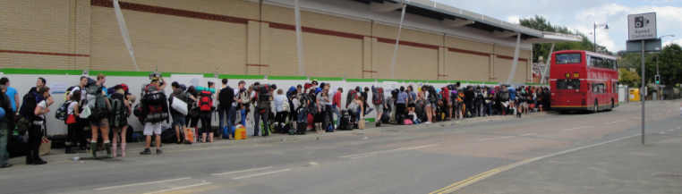
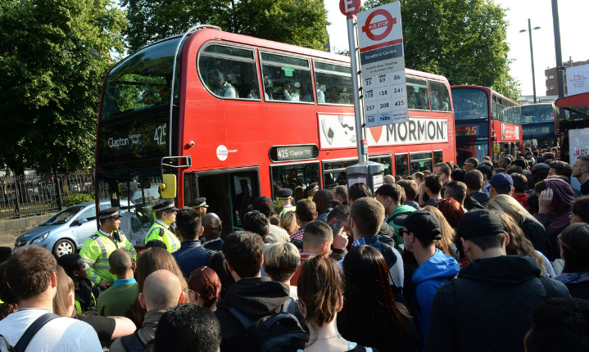
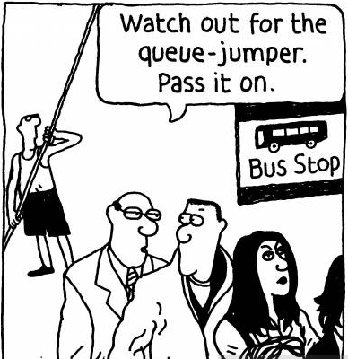
Improvement?!

Slide 93
Path Compression
After finding the root: set the parent of each traversed node to the root.
7
2
8
1
3
5
6
4
0
11
10
12
13

Slide 94
Path Compression
After finding the root: set the parent of each traversed node to the root.
7
2
8
1
3
5
6
4
0
11
10
12
13
find(11, 32)

Slide 95
Path Compression
After finding the root: set the parent of each traversed node to the root.
7
7
2
8
6
11
1
2
8
1
3
5
4
3
5
0
12
13
6
4
10
0
11
10
12
13
find(11, 32)

Slide 96
Path Compression
findRoot(int p) {
root = p;
while (parent[root] != root) root = parent[root];
return root;
}

Slide 97
Path Compression
findRoot(int p) {
root = p;
while (parent[root] != root) root = parent[root];
while (parent[p] != p) {
temp = parent[p];
parent[p] = root;
p = temp;
}
return root;
}

Slide 98
Alternative Path Compression
findRoot(int p) {
root = p;
while (parent[root] != root) {
parent[root] = parent[parent[root]];
root = parent[root];
}
return root;
}
Make every other node in the path point to its grandparent!
Simple
Works as well!
Notes:
Add picture here!

Slide 99
How fart fast can it be?!
Theorem: [Tarjan 1975]
Starting from empty, any sequence of m union/find operations on n objects takes: O(n + mα(m, n)time.
Inverse Ackermann function: always ≤ 5 in this universe.
n | α(n, n)
4 | 0
8 | 1
32 | 2
8,192 | 3
2⁶⁵⁵³³ | 4

Slide 100
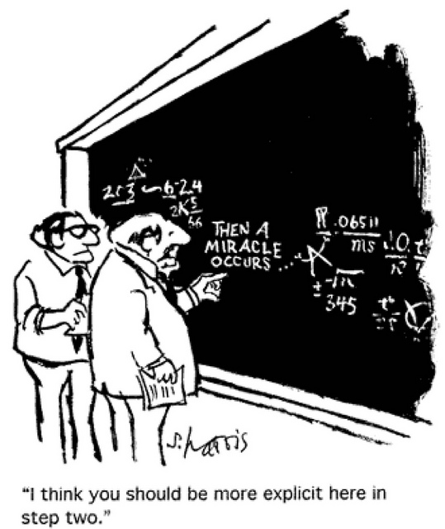
Weight Union with Path Compression
Theorem: [Tarjan 1975]
Starting from empty, any sequence of m union/find operations on n objects takes: O(n + mα(m, n)time.
Proof:

Slide 101
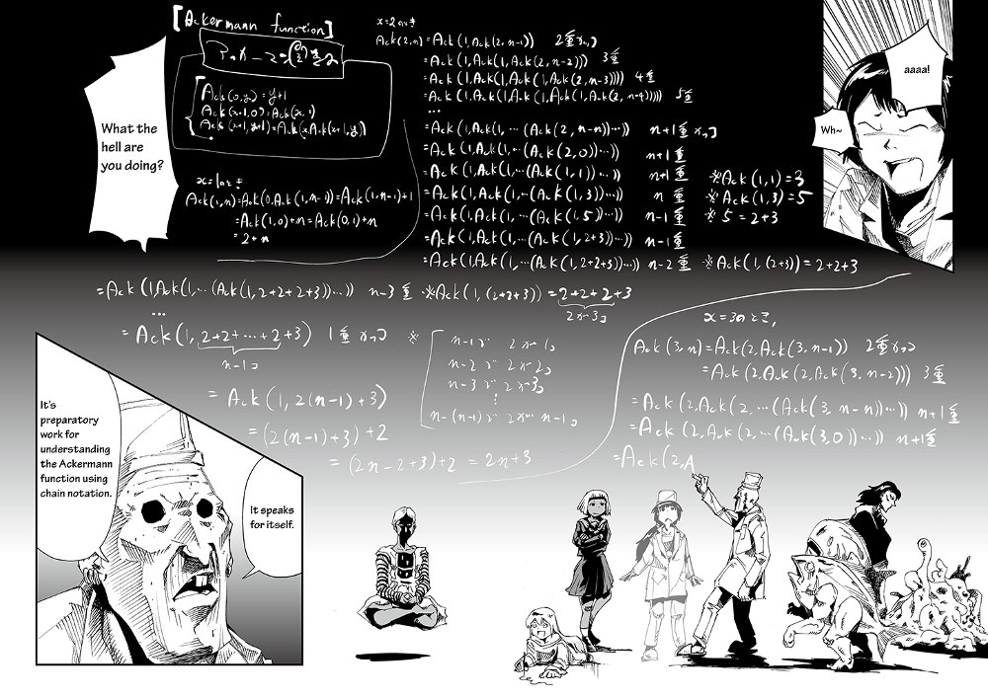

Slide 102
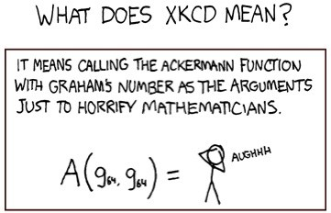
Weight Union with Path Compression
Theorem: [Tarjan 1975]
Starting from empty, any sequence of m union/find operations on n objects takes: O(n + mα(m, n)time.
Proof:
Very difficult.
Algorithm:
very simple to implement.

Slide 103
Weight Union with Path Compression
Theorem: [Tarjan 1975]
Starting from empty, any sequence of m union/find operations on n objects takes: O(n + mα(m, n)time.
Proof:
Very difficult.
Algorithm: very simple to implement.
Can we do better? No!
Proof: impossible to achieve linear time.

Slide 104
Union-Find Summary
Weighted-union is faster:
Trees are flat: O(log n)
Union and find are O(log n)
Weighted Union + Path Compression is very fast:
Trees very flat.
On average, almost linear performance per operation.
 | find | union
quick-find | O(1) | O(n)
quick-union | O(n) | O(n)
weighted-union | O(log n) | O(log n)
weighted-union with path-compression | α(m, n) | α(m, n)

Slide 105
Union-Find Summary
Path Compression without weighted union?
 | find | union
quick-find | O(1) | O(n)
quick-union | O(n) | O(n)
weighted-union | O(log n) | O(log n)
path compression | O(log n) | O(log n)
weighted-union with path-compression | α(m, n) | α(m, n)

Slide 106
Binomial Trees:
Order k binomial trees
0
1
2
3
Notes:
Time tight, but good. No graphs for some of the interactive slides (notably those at the end of the heap section). Tired audience, but ok. Didn’t get to any applications.

Slide 107
Binomial Trees:
Two order k binomial trees can be merged into one k+1 binomial tree
+
=
2
2
3
Notes:
Time tight, but good. No graphs for some of the interactive slides (notably those at the end of the heap section). Tired audience, but ok. Didn’t get to any applications.

Slide 108
Binomial Heap: To store n items
How many trees do we need?
Convert n into binary. The number of binomial trees we need is the number of “1” of n in binary form
E.g. if we have 6 items in ONE set, we need two binomial trees of order 1 and 2
6_{(dec)} = 110_{(bin)}
1
2

Slide 109
Union of Two Binomial Heap
So it’s like adding two binary numbers
E.g. two sets with cardinalities 5 and 13
First set will have trees of order 0 and 2
Second set will have trees of order 0, 2 and 3
+
0
2
0
2
3

Slide 110
Union of Two Binomial Heap
Merge from lowest order first
2
2
3
+
=
0
0
1

Slide 111
Union of Two Binomial Heap
Merge from lowest order first
2
2
3
1

Slide 112
Union of Two Binomial Heap
Merge from lowest order first
3
+
=
2
2
3
1

Slide 113
Union of Two Binomial Heap
Merge from lowest order first
+
3
3
1

Slide 114
Union of Two Binomial Heap
Merge from lowest order first
5_{(dec)} + 13_{(dec)} = 18_{(dec)}
101_{(bin)} + 1101_{(bin)} = 10010_{(bin)}
O(log n) time
1
4

Slide 115
Binomial Trees:
B4 = (root + B0 + B1 + B2 + B3) = (B3 + B3)

Slide 116
Binomial Trees:
size(Bk) = Θ(2^{k})
height(Bk) = k-1

Slide 117
To store a set of n items

Slide 118
Union Find Example:
Step 1: Build Binomial tree using union operations.
Leave some extra objects free.

Slide 119
Union Find Example:
Step 1: Build Binomial tree using union operations.
Step 2: Union: create new root [O(1)]

Slide 120
Union Find Example:
Step 1: Build Binomial tree using union operations.
Step 2: Union: create new root [O(1)]
Step 3: Find deepest leaf [O(log n)]

Slide 121
Union Find Example:
Step 1: Build Binomial tree using union operations.
Step 2: Union: create new root [O(1)]
Step 3: Find deepest leaf [O(log n)]
Path compression…

Slide 122
Union Find Example:
Step 1: Build Binomial tree using union operations.
Step 2: Union: create new root [O(1)]
Step 3: Find deepest leaf [O(log n)]
Path compression…
Still a Binomial tree!

Slide 123
Union Find Example:
Step 1: Build Binomial tree using union operations.
Step 2: Union: create new root [O(1)]
Step 3: Find deepest leaf [O(log n)]
Step 4: Goto step 2.

Slide 124
Union-Find Summary
Path Compression without weighted union?
 | find | union
quick-find | O(1) | O(n)
quick-union | O(n) | O(n)
weighted-union | O(log n) | O(log n)
path compression | O(log n) | O(log n)
weighted-union with path-compression | α(m, n) | α(m, n)

Slide 125
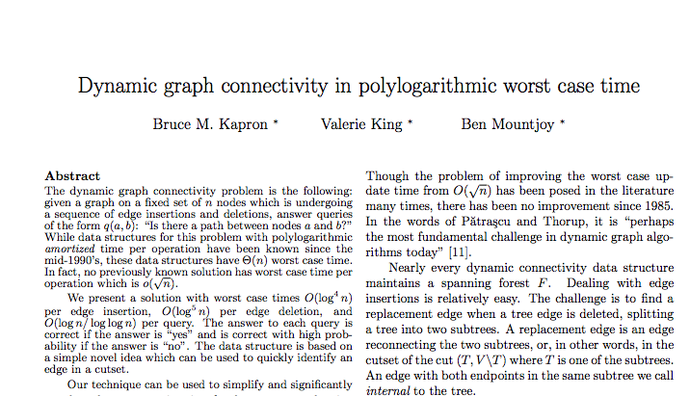
Union-Find Summary
What about Union-Split-Find?
Insert and delete edges.
New result: 2013!!

Slide 126
Roadmap
Part I: Priority Queues
Binary Heaps
HeapSort
Part II: Disjoint Set
Problem: Dynamic Connectivity
Algorithm: Union-Find
Applications

Slide 127
Applications
Many applications:
Mazes
Are two locations connected?
Games:
Can you get from one state to another?

Slide 128
Applications
Many applications:
Networks
Are two locations connected?
Least-common-ancestor:
Which node in a tree network is the closest ancestor?

Slide 129
Applications
Many applications:
Programming languages
Hinley-Milner polymorphic type inference
Equivalence of finite state automata
Image processing in Matlab
Physics:
Hoshen-Kopelman algorithm
Percolation
Conductance / insulation

Slide 130
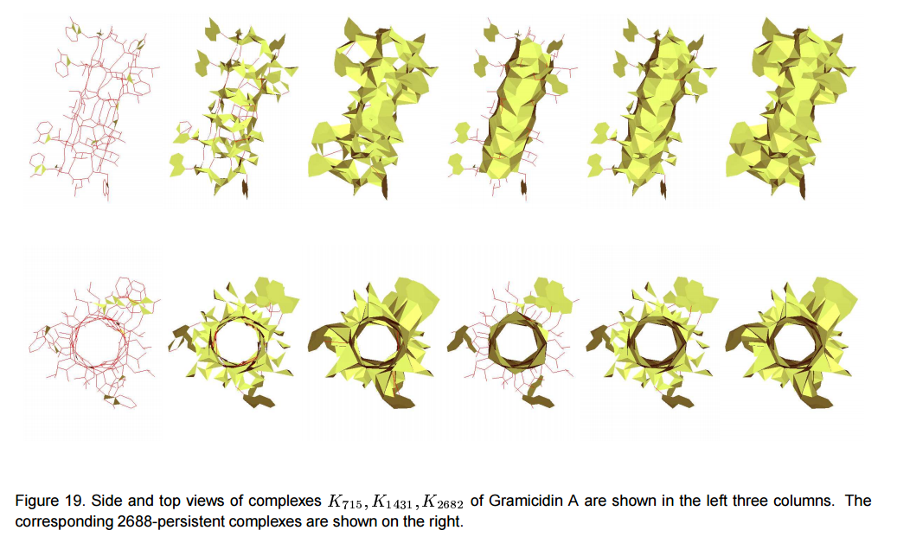
Applications
Many applications:
Topology in Molecular Design

Slide 131
Percolation
Physical system:
n-by-n grid
Each site open with probability p
Are the top and bottom connected?

Slide 132
Percolation
Physical system:
n-by-n grid
Each site open with probability p
Are the top and bottom connected?

Slide 133
Percolation
Physical system:
Sharp threshold p*:
p>p* : percolates
p<p* : does not percolate
Via simulation: p* = 0.592746

Slide 134
Percolation
Simulation:
Add each site to union-find object.
Connect all open sites to neighboring open sites.
For every pair on the top/bottom row, check if connected.

Slide 135
Percolation
Slightly better:
Create virtual top and bottom.
Only check if top and bottom are connected.
Top
Bottom

Slide 136
Roadmap
Part I: Priority Queues
Binary Heaps
HeapSort
Part II: Disjoint Set
Problem: Dynamic Connectivity
Algorithm: Union-Find
Applications

